Slide 1

6th Grade Accelerated Math
Unit 10, Lesson 2 Outliers Volume 2, pg. 109

Slide 2


Benchmarks
MA.6.DP.1.6
Given a real-world scenario, determine and describe how changes in data values impact measures of center and variation.
MA.7.DP.1.1
Determine an appropriate measure of center or measure of variation to summarize numerical data, represented numerically or graphically, taking into consideration the context and any outliers.
volume 2, pg. 109

Slide 3
Integrated Mathematical Thinking and Reasoning Standards
MA.K12.MTR.1.1 Actively participate in effortful learning both individually and collectively.
MA.K12.MTR.4.1 Engage in discussions that reflect on the mathematical thinking of self and others.
MA.K12.MTR.5.1 Use patterns and structure to help understand and connect mathematical concepts.
MA.K12.MTR.7.1 Apply mathematics to real-world contexts.
volume 2, pg. 109

Slide 4

Learning Targets
I can determine the implications an outlier has in a given data set.
I can relate the impact of an outlier to which measures of center and variation best describe a distribution.
volume 2, pg. 109

Slide 5

Warm-Up
volume 2, pg. 109

Slide 6
10.2.1 Warm-Up: Precision Is Key
Becky Miller is a quality control engineer with GE Aviation. Like many other careers, manufacturing engineering has many moving parts that make up an entire process. Becky says that manufacturing is problem-solving.
List at least two steps that you take when faced with a difficult task.
Becky mentions that an error “about the size of a human hair” can make a difference in manufacturing jet engines.
What is a time that you have made a small error that caused a big impact in your next steps?
volume 2, pg. 109

Slide 7

Exploration
volume 2, pg. 110

Slide 8

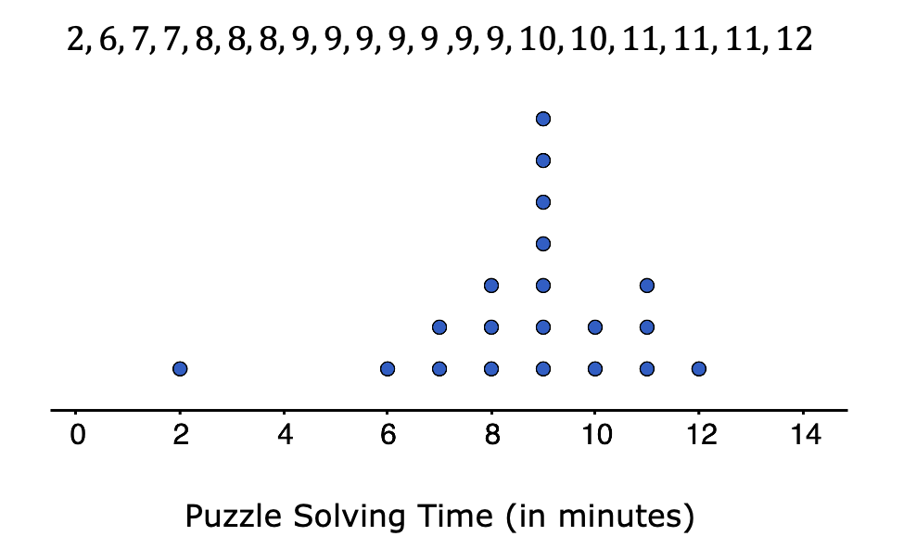
10.2.2 Exploration: Determining, Describing, and Comparing Numerical Data Represented Graphically
Work with your partner to complete the following.
Twenty students timed how long it took each of them to solve a puzzle. Below is a list of their solution times, in minutes, and a dot plot displaying the data.
volume 2, pg. 110

Slide 9

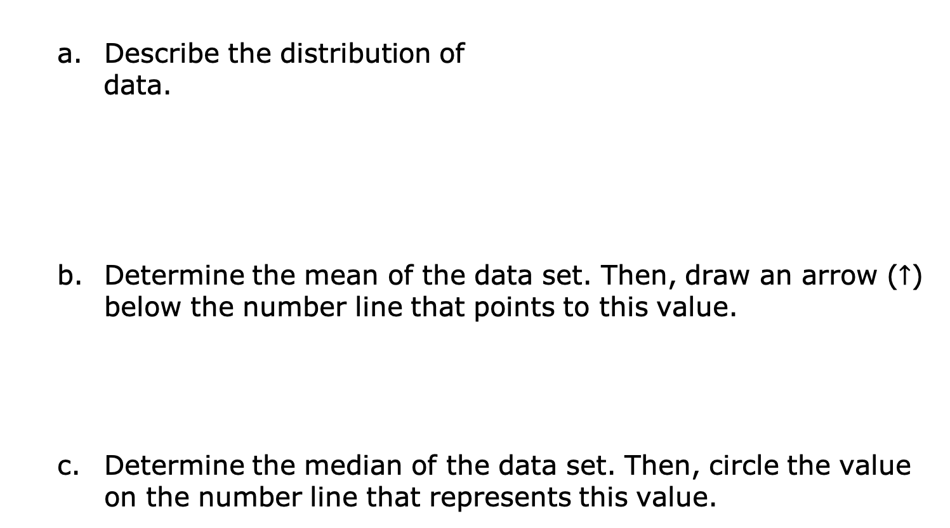
Describe the distribution of
data.
Determine the mean of the data set. Then, draw an arrow ($↑$) below the number line that points to this value.
Determine the median of the data set. Then, circle the value on the number line that represents this value.
volume 2, pg. 110

Slide 10
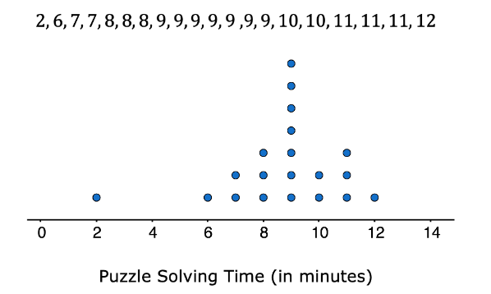
Discuss with your partner
what you notice about the
mean and the median of the
data. Summarize your
discussion.
What is the range of the data?
Find the interquartile range (IQR).
Q1 | Q3 | IQR
volume 2, pg. 110

Slide 11
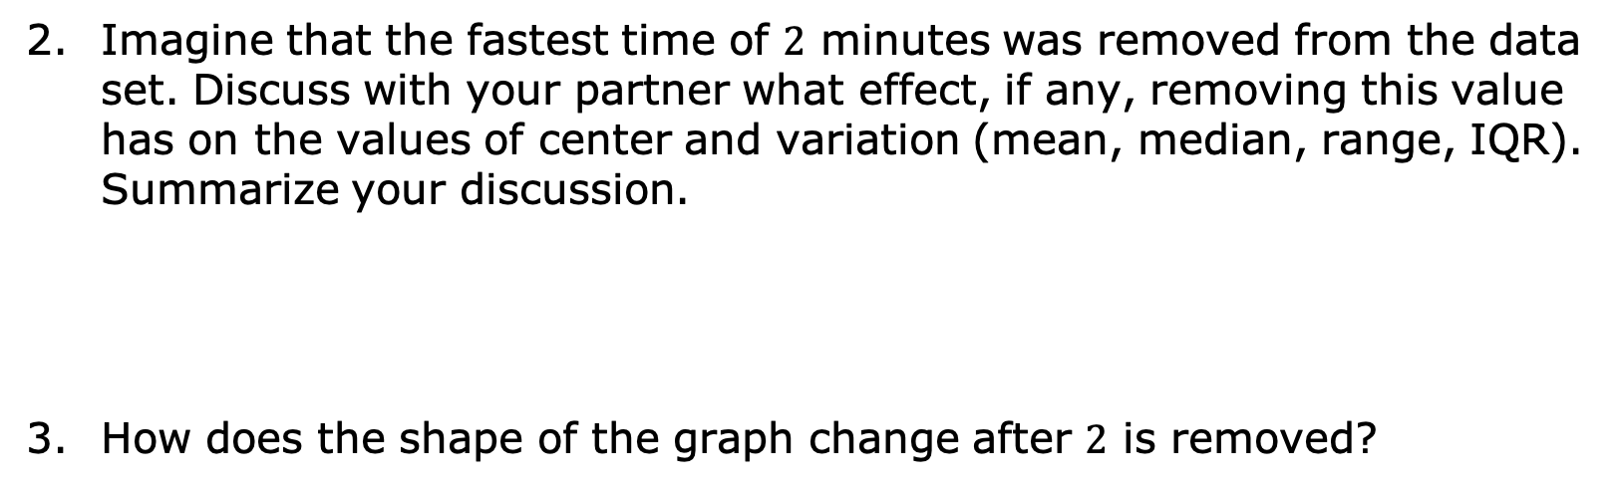
Imagine that the fastest time of $2$ minutes was removed from the data set. Discuss with your partner what effect, if any, removing this value has on the values of center and variation (mean, median, range, IQR). Summarize your discussion.
How does the shape of the graph change after $2$ is removed?
volume 2, pg. 110

Slide 12
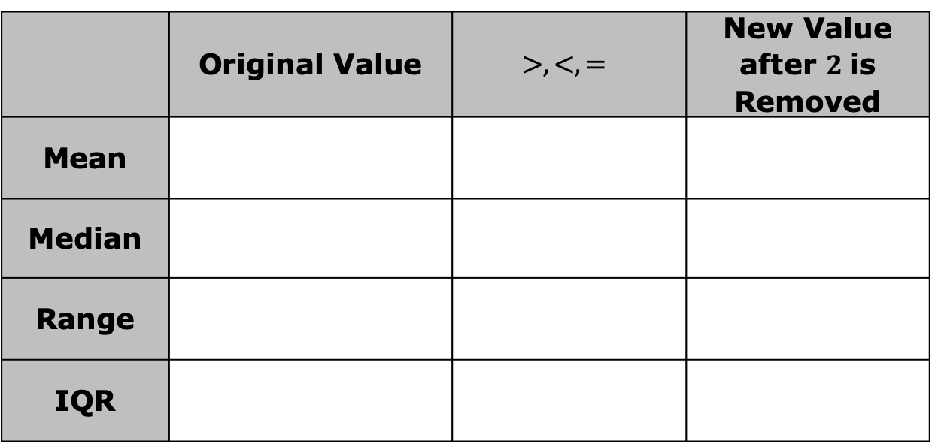
Compare the new values with the original values.
 | Original Value | $$>,<,=$$ | New Value after $2$is Removed
Mean
Median
Range
IQR
volume 2, pg. 111

Slide 13
Which measure(s) of center will be affected if the outlier is removed?
Which measure(s) of variation will be affected if the outlier is removed?
mean
median
both the mean and median
range
interquartile range
both the range and the interquartile range
volume 2, pg. 111

Slide 14

Bring It Together
volume 2, pg. 111

Slide 15

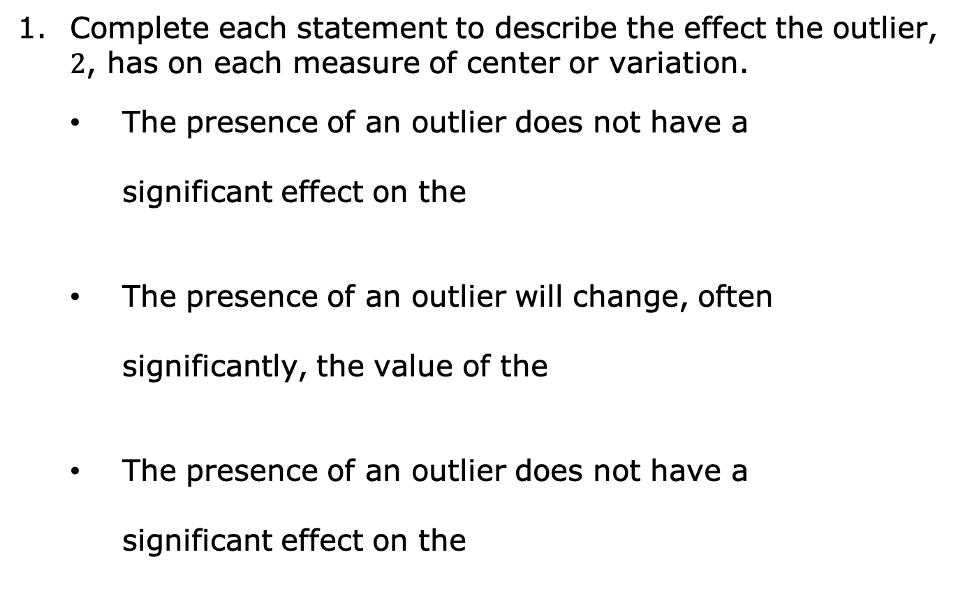
10.2.3 Bring It Together: Outlier Effects
Complete each statement to describe the effect the outlier, $2$, has on each measure of center or variation.
The presence of an outlier does not have a
significant effect on the
The presence of an outlier will change, often
significantly, the value of the
The presence of an outlier does not have a
significant effect on the
mean.
median.
mean.
median.
IQR.
range.
volume 2, pg. 111

Slide 16

The presence of an outlier will change, often
significantly, the value of the
IQR.
range.
When outliers are present or a distribution is skewed, the ____________ is the preferred measure of center and the _________ is the preferred measure of variation to describe the distribution.
volume 2, pg. 111

Slide 17

Guided Practice
volume 2, pg. 112

Slide 18

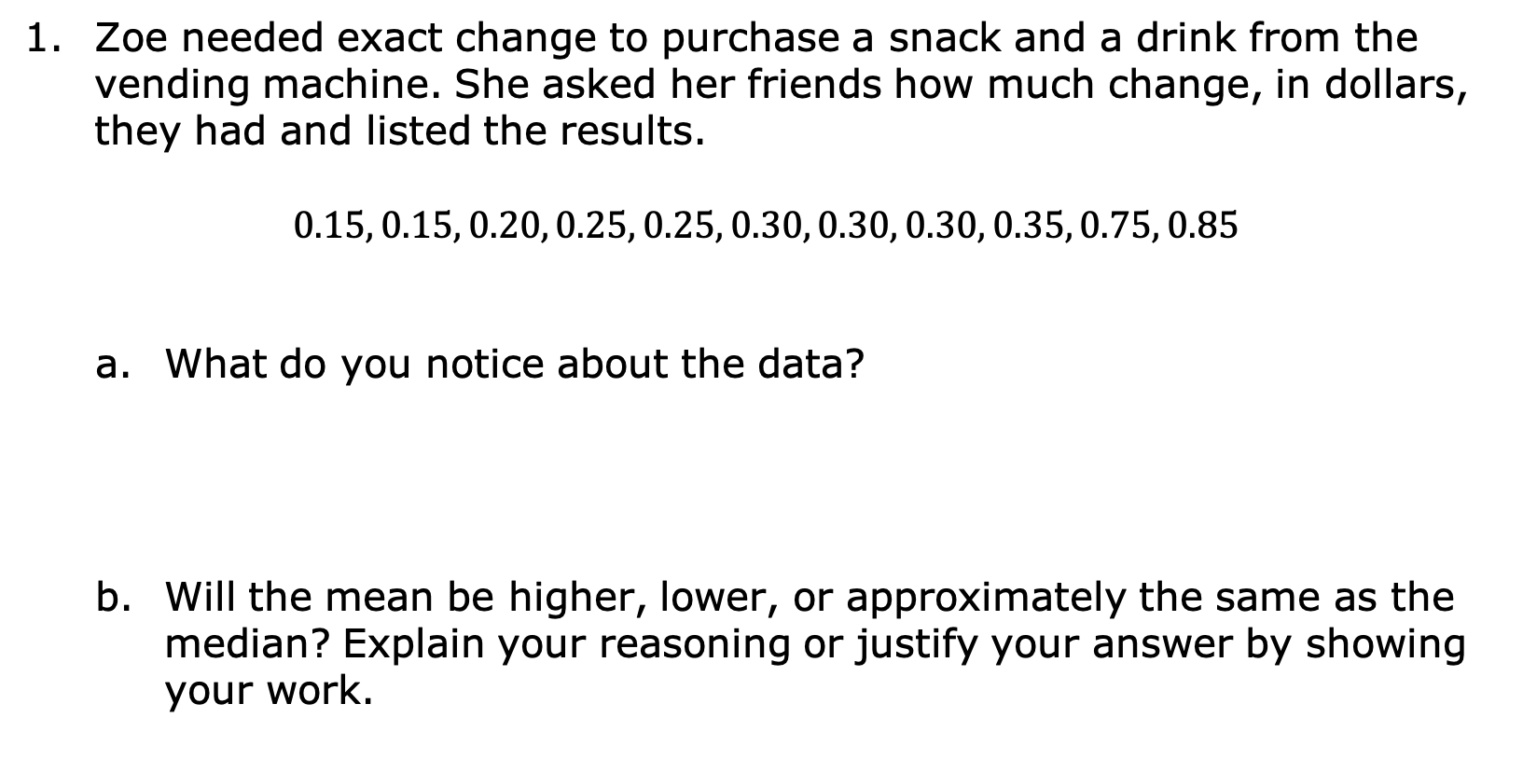
10.2.4 Guided Practice: Data Outliers
Zoe needed exact change to purchase a snack and a drink from the vending machine. She asked her friends how much change, in dollars, they had and listed the results.
$$0.15, 0.15, 0.20, 0.25, 0.25, 0.30, 0.30, 0.30, 0.35, 0.75, 0.85$$
What do you notice about the data?
Will the mean be higher, lower, or approximately the same as the median? Explain your reasoning or justify your answer by showing your work.
volume 2, pg. 112

Slide 19
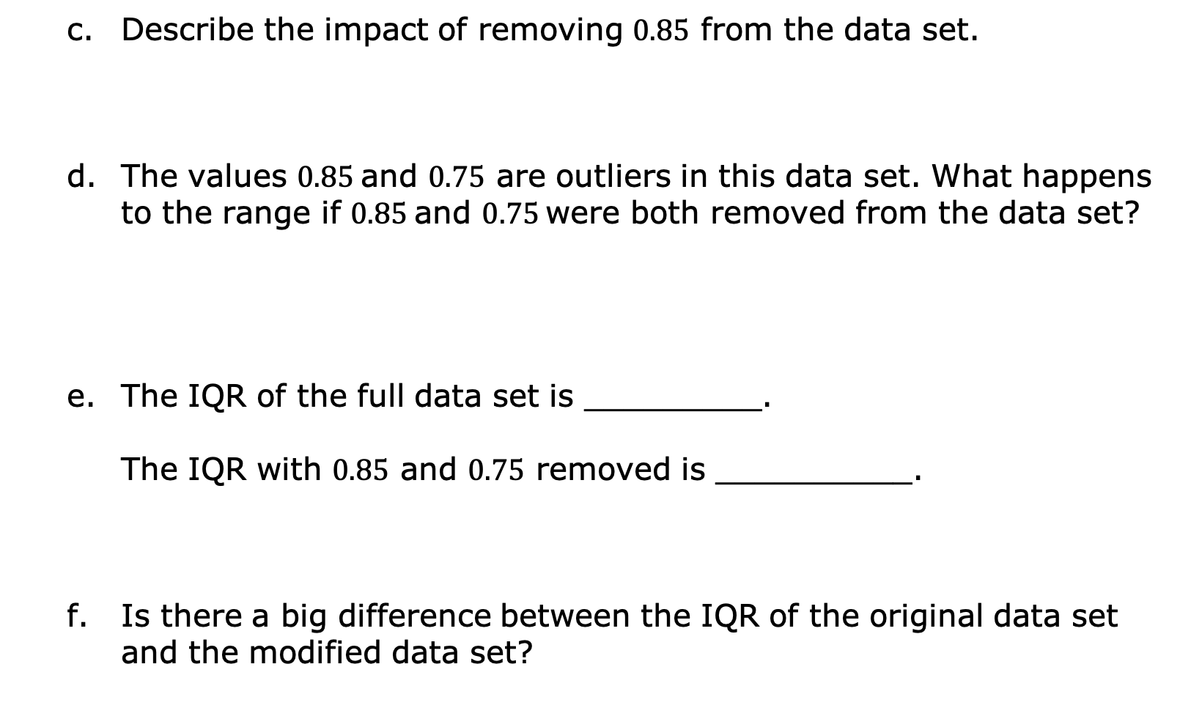
Describe the impact of removing $0.85$ from the data set.
The values $0.85$and $0.75$ are outliers in this data set. What happens to the range if $0.85$and $0.75$ were both removed from the data set?
The IQR of the full data set is _________.
The IQR with $0.85$ and $0.75$ removed is __________.
Is there a big difference between the IQR of the original data set and the modified data set?
volume 2, pg. 112

Slide 20
Exploration
volume 2, pg. 113

Slide 21
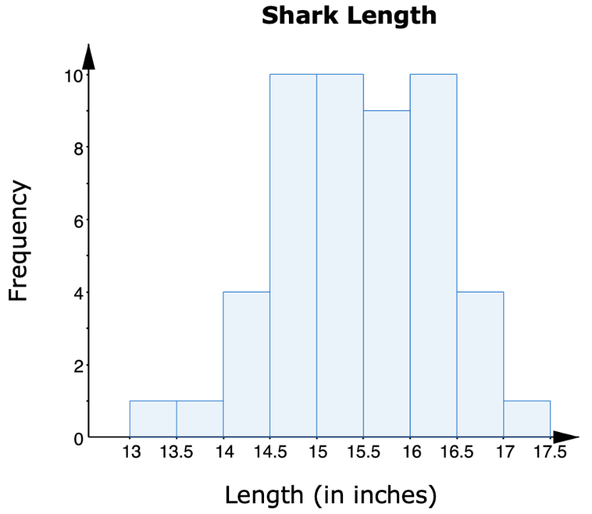
10.2.5 Exploration: Measures of Center
Consider the histogram of the lengths of female sharks.
volume 2, pg. 113

Slide 22
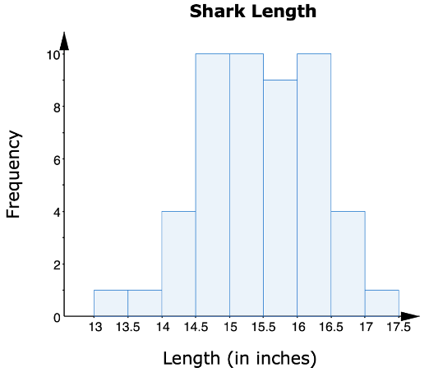
Describe the shape of the
histogram.
Circle the value on the horizontal axis of the graph that shows the approximate location of the median of the data.
Draw an arrow (↑) on the graph to indicate the approximate location of the mean of the data.
volume 2, pg. 113

Slide 23
Compare your answers to B and C with your partner’s answers. Discuss your reasoning and, if necessary, make changes.
In a symmetrical graph, the mean and the median are located in the middle of the graph, approximately in the same location.
volume 2, pg. 113

Slide 24
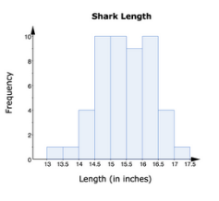
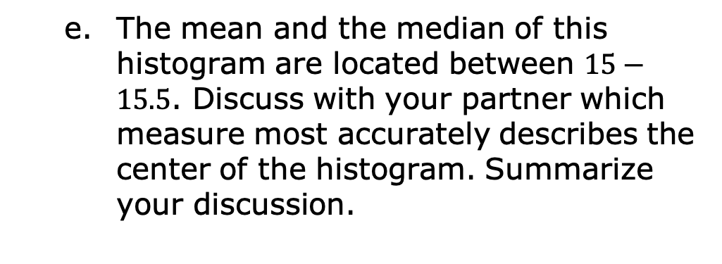
The mean and the median of this histogram are located between $15−15.5$. Discuss with your partner which measure most accurately describes the center of the histogram. Summarize your discussion.
In a symmetrical graph with no outliers, the __________ is the preferred measure of center and the ___________ is the preferred measure of variation to describe the distribution.
volume 2, pg. 113

Slide 25
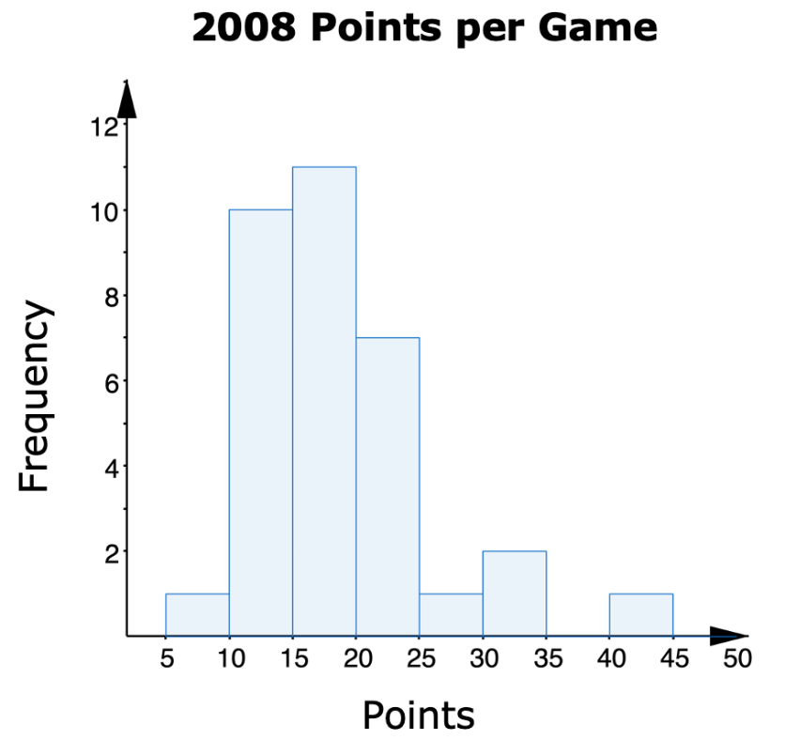
The histogram displays the number of points per game scored by a college basketball player during the 2008 season.
volume 2, pg. 114

Slide 26
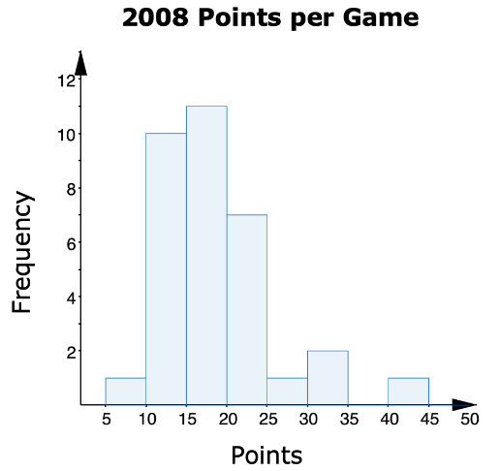
Describe the shape of the
histogram.
Circle the value on the horizontal axis of the graph that shows the approximate location of the median of this data.
Draw an arrow (↑) on the graph to indicate the approximate location of the mean of the data.
volume 2, pg. 114

Slide 27
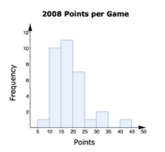
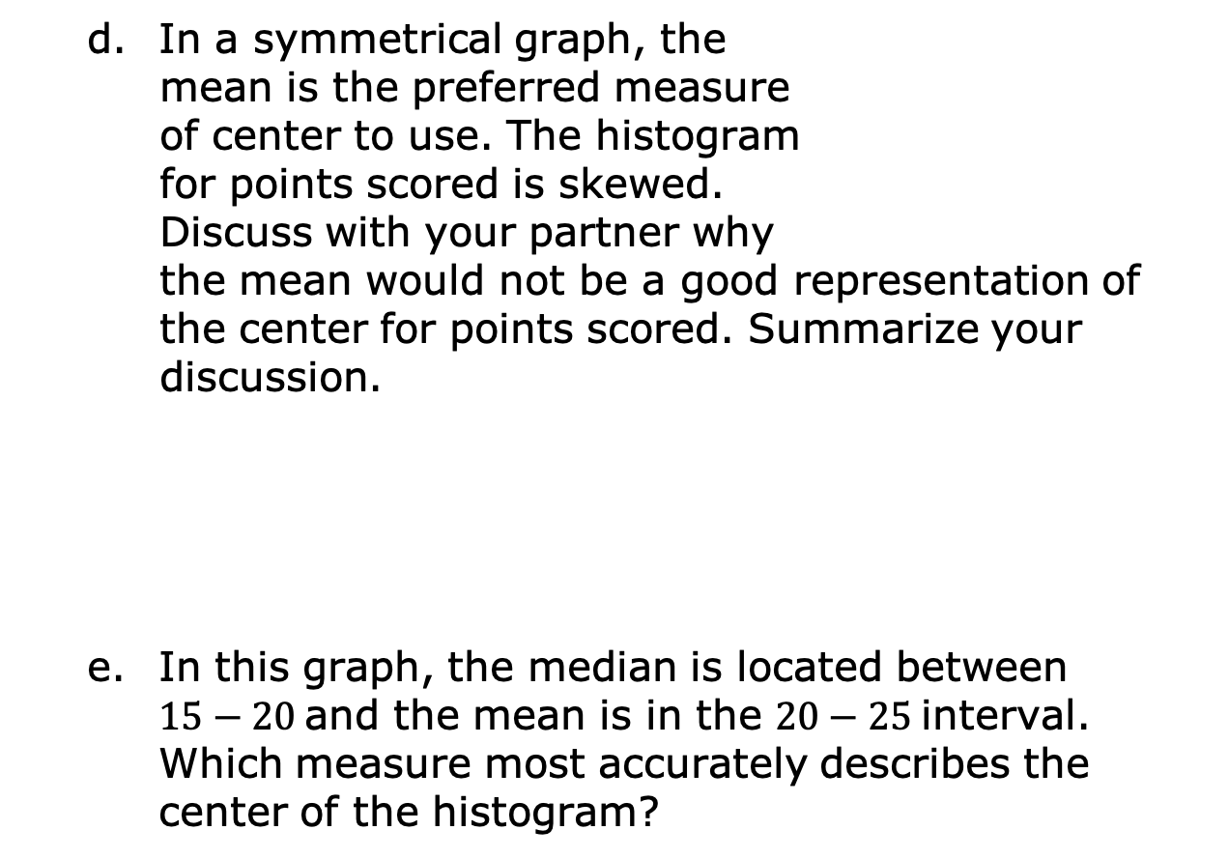
In a symmetrical graph, the
mean is the preferred measure
of center to use. The histogram
for points scored is skewed.
Discuss with your partner why
the mean would not be a good representation of the center for points scored. Summarize your
discussion.
In this graph, the median is located between
$15−20$ and the mean is in the $20−25$ interval. Which measure most accurately describes the center of the histogram?
volume 2, pg. 114

Slide 28
Which measure of variation should be used to describe the distribution?
In a skewed graph or a graph with outliers, the ____________ is the preferred measure of center and the _____________ is the preferred measure of variation to describe the distribution.
volume 2, pg. 114

Slide 29

Your Turn
volume 2, pg. 115

Slide 30
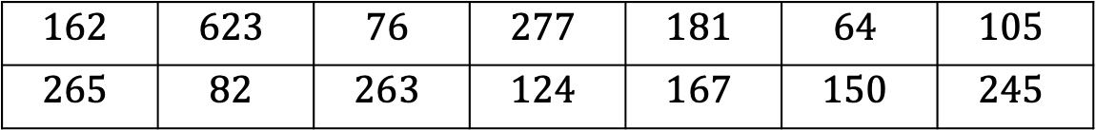
10.2.6 Your Turn!
The following data set shows the number of tickets a movie theater sold in one day for each movie that is playing at the theater.
One of the values in the data set is an outlier. Explain which value you think is the outlier.
$$162$$ | $$623$$ | $$76$$ | $$277$$ | $$181$$ | $$64$$ | $$105$$
$$265$$ | $$82$$ | $$263$$ | $$124$$ | $$167$$ | $$150$$ | $$245$$
volume 2, pg. 115

Slide 31
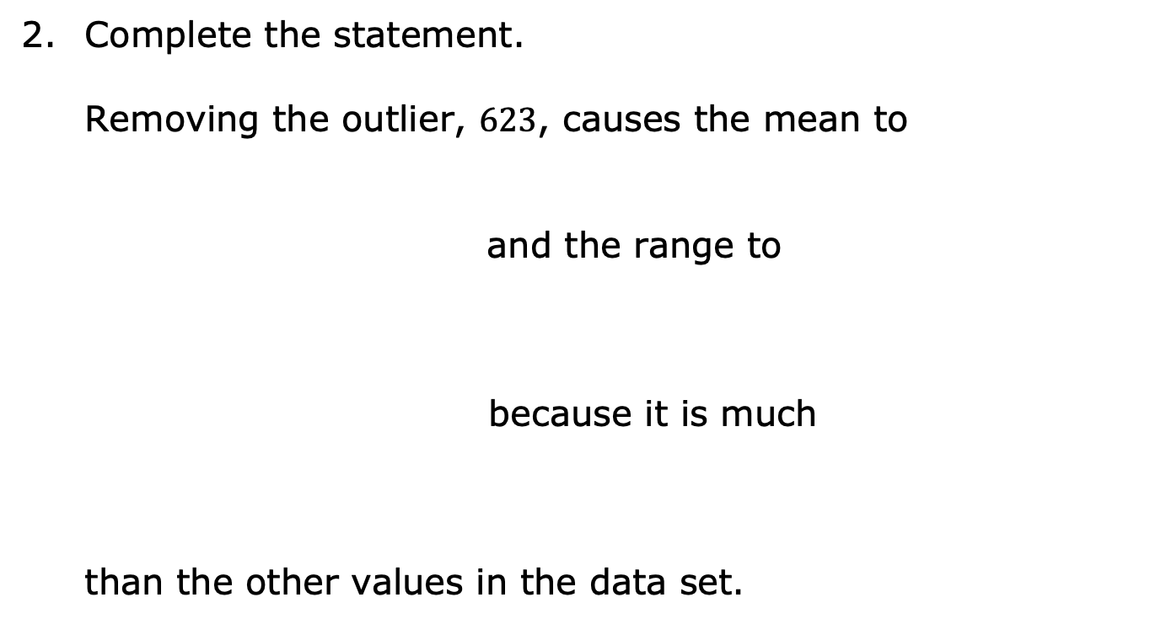
Complete the statement.
Removing the outlier, $623$, causes the mean to
and the range to
because it is much
than the other values in the data set.
increase
decrease
remain the same
increase
decrease
remain the same
larger
smaller
volume 2, pg. 115

Slide 32

Wrap-Up
volume 2, pg. 115

Slide 33
10.2.7 Wrap-Up: Cool Down
The presence of an outlier has a significant effect on which measures of center and spread? Select all that apply.
Mean
Median
Interquartile Range
Range
volume 2, pg. 115

Slide 34
A data set has an outlier that is significantly less than most of the other values.
Explain how this impacts the measures selected in number 1.
Which measures of center and variation would you use to best describe the data?
volume 2, pg. 115

